Slide 1
Welcome to Week 6

Slide 2
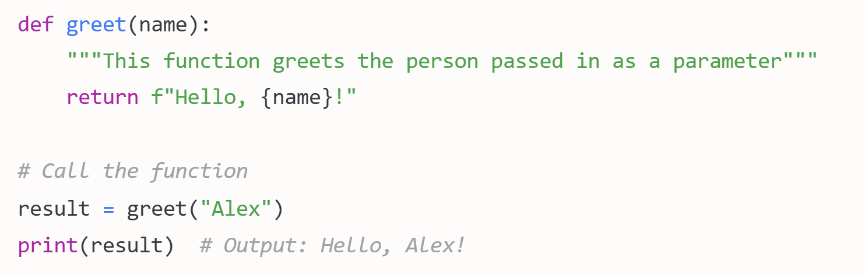
Function
In Python, functions are defined using the def keyword, followed by the function name, parentheses containing any parameters, and a colon. The function body is indented beneath.

Slide 3
Functions can:
Accept multiple parameters (including optional ones with default values)
Return values using the Return Statement
Contain docstrings (like the comment in triple quotes above) to document what they do
Process any type of data

Slide 4
Review the following questions that will be discussed in the tutorial session.
Why are functions important in Python?
What does it mean that functions can return any type of object?

Slide 5
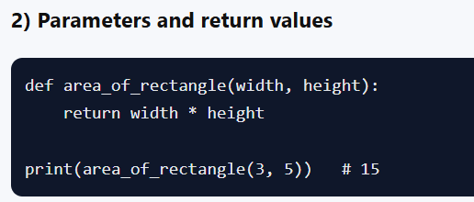
Why are functions important in Python?
Notes:
Code Reusability: Functions allow you to write a block of code once and reuse it multiple times. This reduces repetition and makes your code more efficient and easier to maintain. You can call the same function with different arguments to perform similar tasks without writing duplicate code.
Modularity: Functions help break down complex problems into smaller, manageable parts. By organizing your code into functions, each with a specific task, it becomes easier to understand, develop, and debug. It also improves the overall structure and readability of the program.
Maintainability: If a change or bug fix is needed, you only need to update the function once, rather than modifying code in multiple places. This reduces the chance of errors and improves the maintainability of the code.
Abstraction: Functions allow you to hide the complexity of the code and focus on the overall logic. When you call a function, you don’t need to worry about how it works internally; you only need to know what it does and what inputs it requires.
Testing: Functions can be tested individually, making it easier to isolate bugs. You can verify the functionality of a single function before integrating it into a larger program, reducing the likelihood of system-wide errors.
Readability: Well-named functions make your code self-explanatory. They describe the task they perform, making the overall code more readable and understandable, even for others who may read your code later.

Slide 6
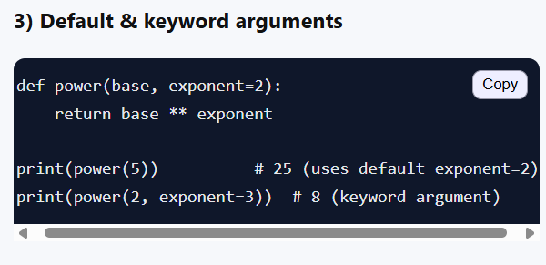
Why are functions important in Python?
Notes:
Code Reusability: Functions allow you to write a block of code once and reuse it multiple times. This reduces repetition and makes your code more efficient and easier to maintain. You can call the same function with different arguments to perform similar tasks without writing duplicate code.
Modularity: Functions help break down complex problems into smaller, manageable parts. By organizing your code into functions, each with a specific task, it becomes easier to understand, develop, and debug. It also improves the overall structure and readability of the program.
Maintainability: If a change or bug fix is needed, you only need to update the function once, rather than modifying code in multiple places. This reduces the chance of errors and improves the maintainability of the code.
Abstraction: Functions allow you to hide the complexity of the code and focus on the overall logic. When you call a function, you don’t need to worry about how it works internally; you only need to know what it does and what inputs it requires.
Testing: Functions can be tested individually, making it easier to isolate bugs. You can verify the functionality of a single function before integrating it into a larger program, reducing the likelihood of system-wide errors.
Readability: Well-named functions make your code self-explanatory. They describe the task they perform, making the overall code more readable and understandable, even for others who may read your code later.

Slide 7
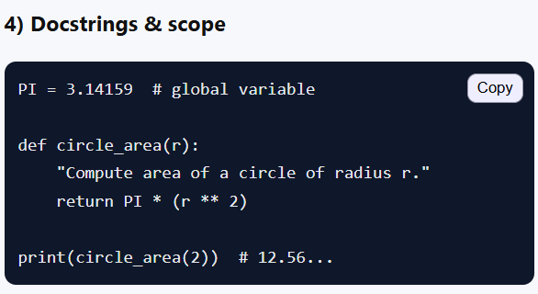
Why are functions important in Python?
Notes:
Code Reusability: Functions allow you to write a block of code once and reuse it multiple times. This reduces repetition and makes your code more efficient and easier to maintain. You can call the same function with different arguments to perform similar tasks without writing duplicate code.
Modularity: Functions help break down complex problems into smaller, manageable parts. By organizing your code into functions, each with a specific task, it becomes easier to understand, develop, and debug. It also improves the overall structure and readability of the program.
Maintainability: If a change or bug fix is needed, you only need to update the function once, rather than modifying code in multiple places. This reduces the chance of errors and improves the maintainability of the code.
Abstraction: Functions allow you to hide the complexity of the code and focus on the overall logic. When you call a function, you don’t need to worry about how it works internally; you only need to know what it does and what inputs it requires.
Testing: Functions can be tested individually, making it easier to isolate bugs. You can verify the functionality of a single function before integrating it into a larger program, reducing the likelihood of system-wide errors.
Readability: Well-named functions make your code self-explanatory. They describe the task they perform, making the overall code more readable and understandable, even for others who may read your code later.

Slide 8

What does it mean that functions can return any type of object?
Primitive Data Types:
A function can return simple data types like integers, floats, strings, or Booleans.
Notes:
In Python, the statement "functions can return any type of object" means that a function can return a value of any data type, such as:

Slide 9

What does it mean that functions can return any type of object?
Collections:
A function can return more complex data structures, such as lists, dictionaries, tuples, or sets.
Notes:
In Python, the statement "functions can return any type of object" means that a function can return a value of any data type, such as:

Slide 10

What does it mean that functions can return any type of object?
None:
A function can return None, which is a special Python value that represents the absence of a value. This is common when the function performs an action but doesn't need to return a result.
Notes:
In Python, the statement "functions can return any type of object" means that a function can return a value of any data type, such as:

Slide 11
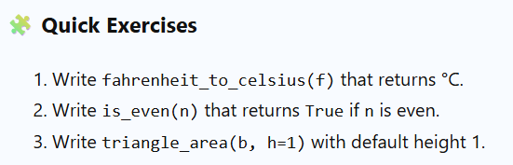

Slide 12
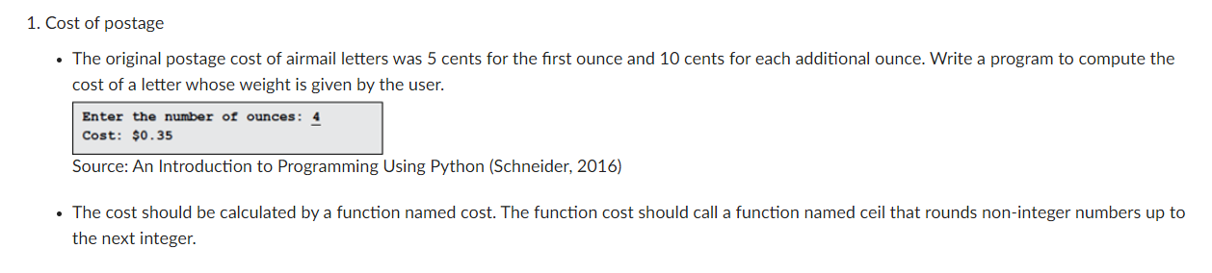
The ceil() function is used to round numbers up to the nearest integer.

Slide 13
Answer 1
def main():
## Calculate the original cost of mailing an airmail letter.
weight = float(input("Enter the number of ounces: "))
print("Cost: ${0:0,.2f}".format(cost(weight)))
def cost(weight):
return 0.05 + 0.1 * ceil(weight - 1)
def ceil(x):
if int(x) != x:
return int(x + 1)
else:
return x
main()
Main Function (main())
Postage Calculation Function (cost())
Ceiling Function (ceil())
Program Execution (Main Program Call)
Notes:
The structure of this code is a typical function-driven programming structure, consisting of a main function main() and two helper functions cost() and ceil(). Below is a detailed breakdown of the structure:
Main Function (main())
Purpose: The main function is the entry point of the program. It is responsible for obtaining input from the user, calling other functions to compute the postage cost, and outputting the result.
Postage Calculation Function (cost())
Purpose: This function calculates the postage cost based on the weight of the letter provided by the user.
Ceiling Function (ceil())
Purpose: This function rounds up any non-integer weight to the nearest whole number, which is important for calculating the extra ounces beyond the first one.
Program Execution (Main Program Call)
The entire program starts with the execution of the main() function, where it takes the input, computes the postage, and displays the output.
Summary:
The code is structured with clear function separation, achieving a modular design where each function focuses on its specific task. This makes the program easier to understand and maintain.

Slide 14
Answer 1
def main():
## Calculate the original cost of mailing an airmail letter.
weight = float(input("Enter the number of ounces: "))
print("Cost: ${0:0,.2f}".format(cost(weight)))
def cost(weight):
return 0.05 + 0.1 * ceil(weight - 1)
def ceil(x):
if int(x) != x:
return int(x + 1)
else:
return x
main()
Weight=3.7
X=weight-1= 2.7
Int(2.7) != 2.7
So return int(2.7+1) (=3)
Notes:
Logical Breakdown:int(x) != x:
This checks if x is an integer. If x is a float, int(x) will remove the decimal portion, leaving only the whole number.
So, if int(x) is not equal to x, it means x is not an integer.return int(x + 1):
If x is not an integer, adding 1 to x and converting it to an integer will round it up.
This achieves the ceiling effect, rounding up to the nearest whole number.
else: return x: If x is already an integer, there’s no need to round up, so it simply returns x as it is.

Slide 15
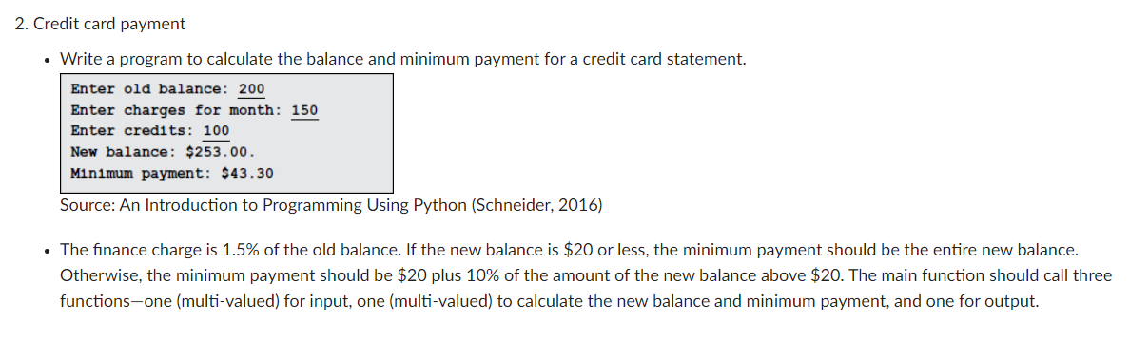

Slide 16
Stage 1: Pure arithmetic
Old balance = 200
Charges = 150
Credits = 100
Steps:
Add finance charge → 1.015 × 200 = 203
Add charges → 203 + 150 = 353
Subtract credits → 353 – 100 = 253.00
Minimum payment rule → 20 + 10% × (253 – 20) = 43.30

Slide 17
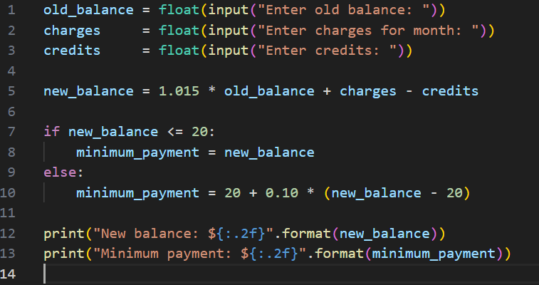
Stage 2: Sequential Python (no functions)

Slide 18
Stage 3: Introduce functions
Functions as little machines:
Input machine: asks the user for numbers.
Calculation machine: does the math.
Output machine: displays results.
This shows why we group code instead of having one long list.

Slide 19
Stage 4: Full structured program

Slide 20
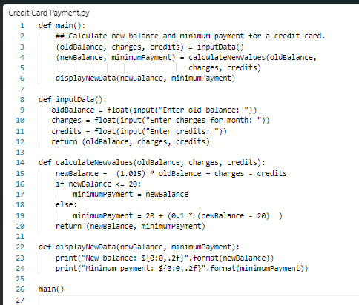

Slide 21
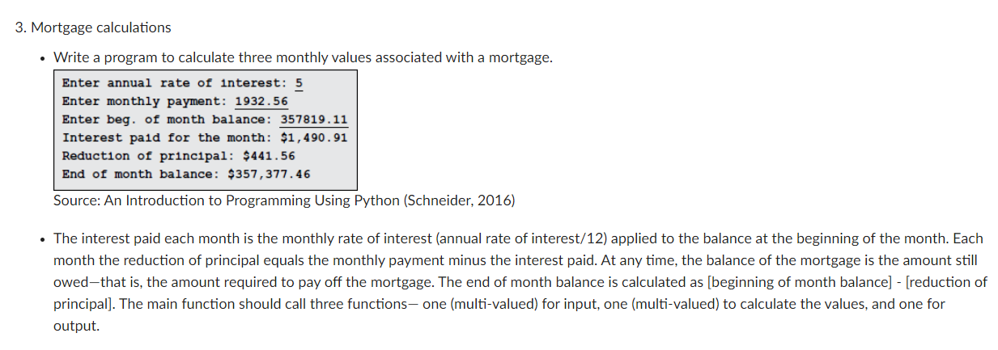

Slide 22
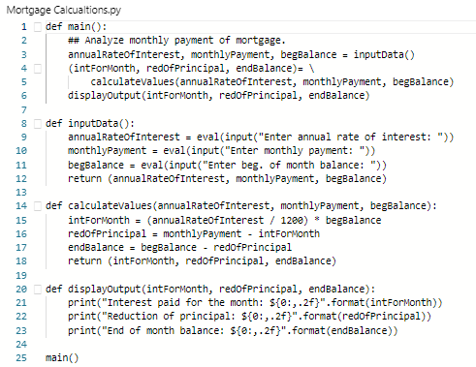

Slide 23
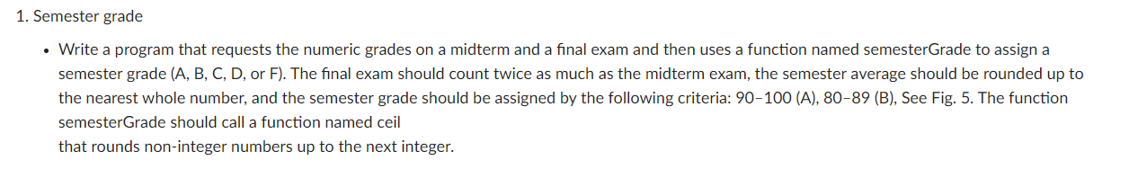
Numeric | Semester grade
>=90 | A
80<= x <90 | B
70<=x<80 | C
60<=x<70 | D
>60 | F

Slide 24
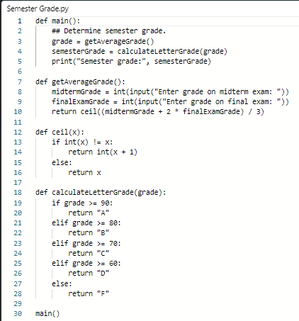

Slide 25
Review the following questions that will be discussed in the tutorial session.
How do you sort items in a list?
What is the function that sorts items in a list?

Slide 26
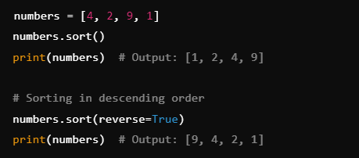

How do you sort items in a list?
Using sort() Method (In-place Sorting)
The sort() method sorts the list in place, meaning the original list is modified and no new list is created. It only works on lists.
list.sort(reverse=False, key=None)
Notes:
In Python, there are two primary ways to sort items in a list: using the sort() method or the sorted() function. Here's how each works:
reverse: A boolean value (True or False). If True, the list is sorted in descending order. The default is False (ascending order).key: A function that serves as a basis for sorting. For example, if you want to sort by length of strings, you can use key=len.

Slide 27
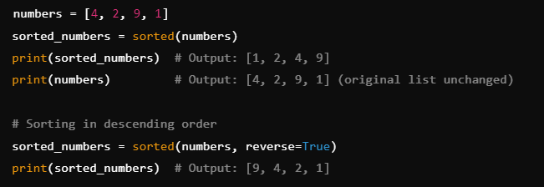
How do you sort items in a list?/ What is the function that sorts items in a list?
2. Using sorted() Function (Returns a New List)
The sorted() function returns a new list while leaving the original list unchanged. This function works on any iterable, not just lists.
sorted(iterable, reverse=False, key=None)
Notes:
In Python, there are two primary ways to sort items in a list: using the sort() method or the sorted() function. Here's how each works:
iterable: Any sequence (e.g., list, tuple, dictionary, string) you want to sort.
reverse and key work the same way as in sort METHOD.

Slide 28
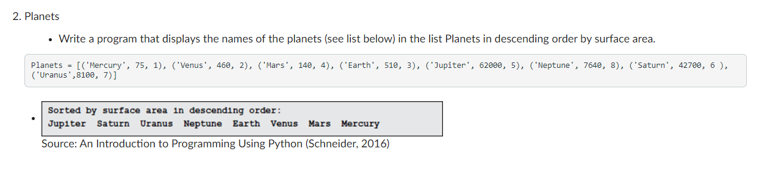

Slide 29
